Slide 1
THE BATTLE OF
NEIGHBORHOODS

Slide 2
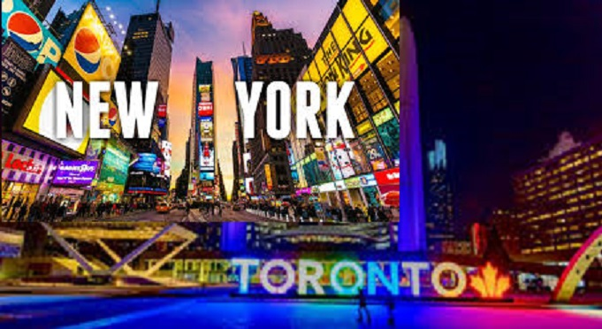

Slide 3
PROBLEM DESCRIPTION
Explore similarities and dissimilarities between the cities of Toronto and New York from tourist perspective.
Exploration on the basis of food, accomodation, places to visit, etc.
Tourists can decide which place to visit on basis of their taste.

Slide 4
DATA ACQUISITION
List of Boroughs and their corresponding Neighborhoods in Toronto, Canada taken from https://en.wikipedia.org/wiki/List_of_postal_codes_of_Canada:_M
Geographical coordinates of every postal code in Toronto, Canada taken from https://cocl.us/Geospatial_data
Dataset containing the Boroughs and the Neighborhoods that exist in each borough along with the geographical coordinates of each neighborhood taken from https://cocl.us/new_york_dataset
Venues and nearby places related information taken from Foursquare API.

Slide 5
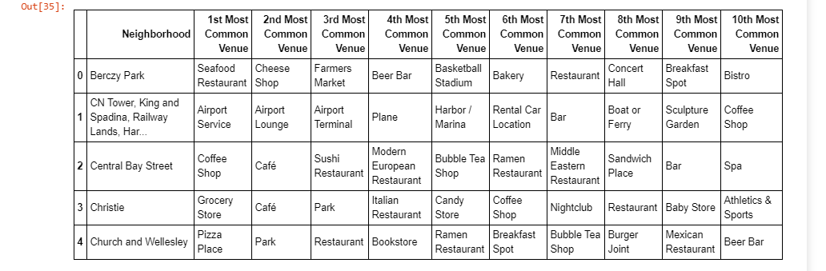
DATA FRAME BEFORE CLUSTERING
DOWNTOWN TORONTO

Slide 6
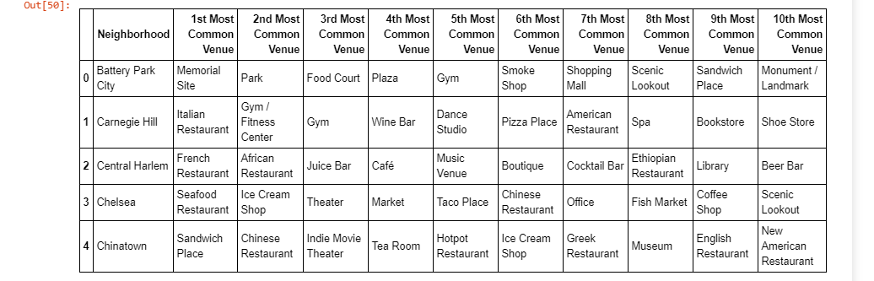
DATA FRAME BEFORE CLUSTERING
MANHATTAN

Slide 7
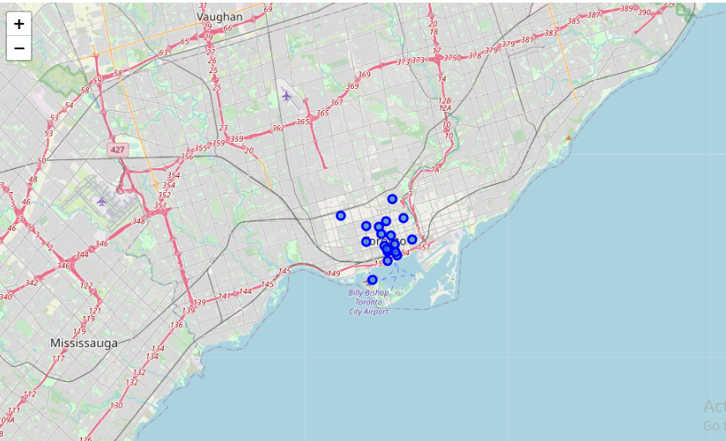
MAP OF DOWNTOWN TORONTO BEFORE CLUSTERING

Slide 8
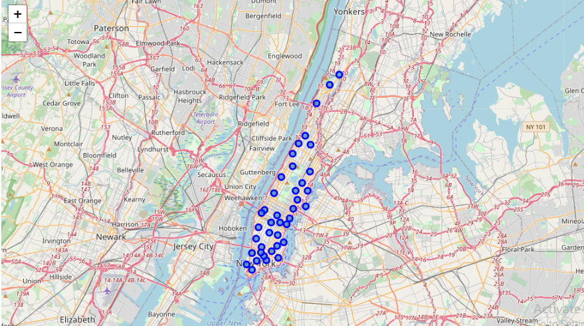
MAP OF MANHATTAN BEFORE CLUSTERING

Slide 9
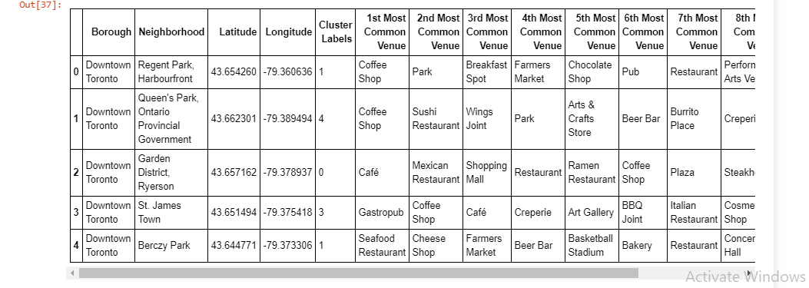
DATA FRAME AFTER CLUSTERING
DOWNTOWN TORONTO

Slide 10
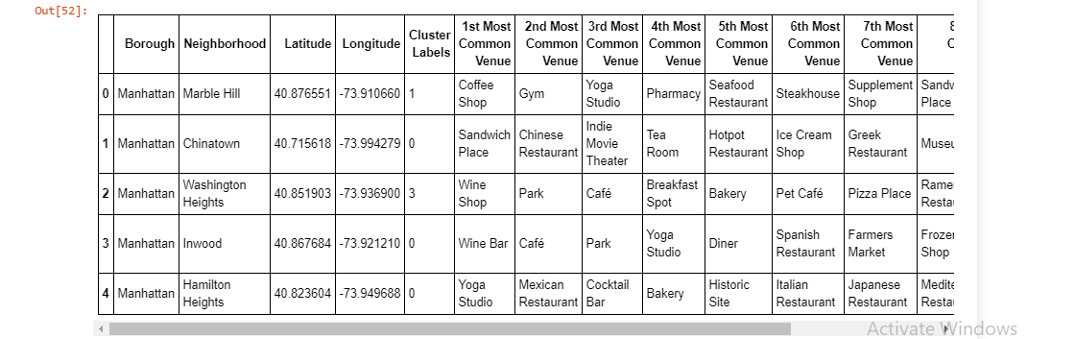
DATA FRAME AFTER CLUSTERING
MANHATTAN

Slide 11
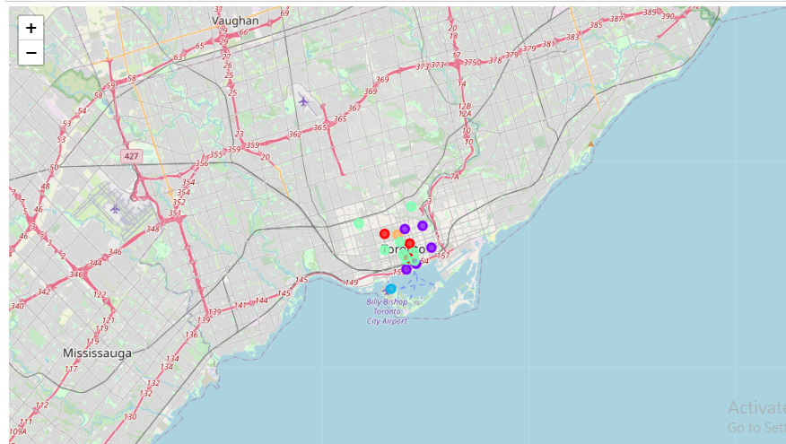
MAP OF DOWNTOWN TORONTO AFTER CLUSTERING

Slide 12
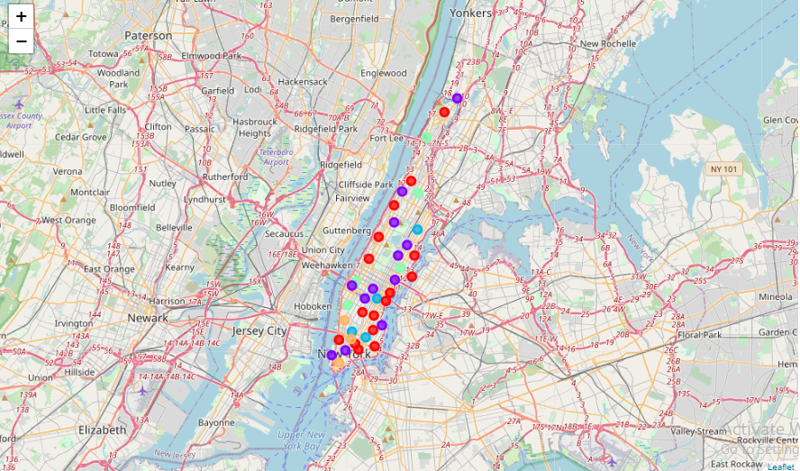
MAP OF MANHATTAN AFTER CLUSTERING

Slide 13
OBSERVATIONS & RECOMMENDATIONS
Historical place in Downtown Toronto & Monument in Manhattan
Airport facility, Harbor, Sculpture garden and Boat or ferry services in Downtown Toronto & Nightlife, Climbing gym and Museums in Manhattan
Downtown Toronto Neighborhoods recommended to visit first. The tourists have easy travelling access due to the Airport facility.

Slide 14
CONCLUSION
The Downtown Toronto and Manhattan neighborhoods have more like similar venues.
Every place is unique in its own way, so that argument is present in both neighborhoods.
The dissimilarity exists in terms of some different venues and facilities but not on a larger extent.

Slide 15
THANK YOU

